Slide 1
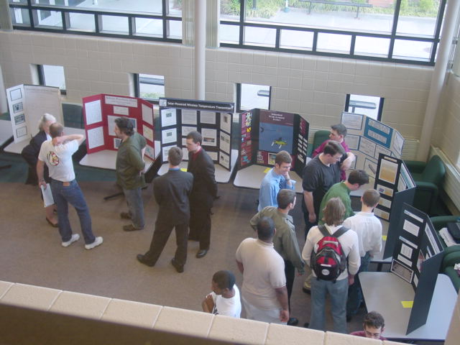
Design Reports
Poster Presentations
25 Posters

Slide 2
Poster Presentations
Plan
  Document your design
  Know the Poster Requirements
  Consider visual effect: Color, composition, graphics, text
Assemble materials
Construct poster
Display poster
25 Posters

Slide 3
Plan: Document Design
Document existing systems
Document progress in a build project
Photograph intermediate steps that are critical to understanding
25 Posters

Slide 4
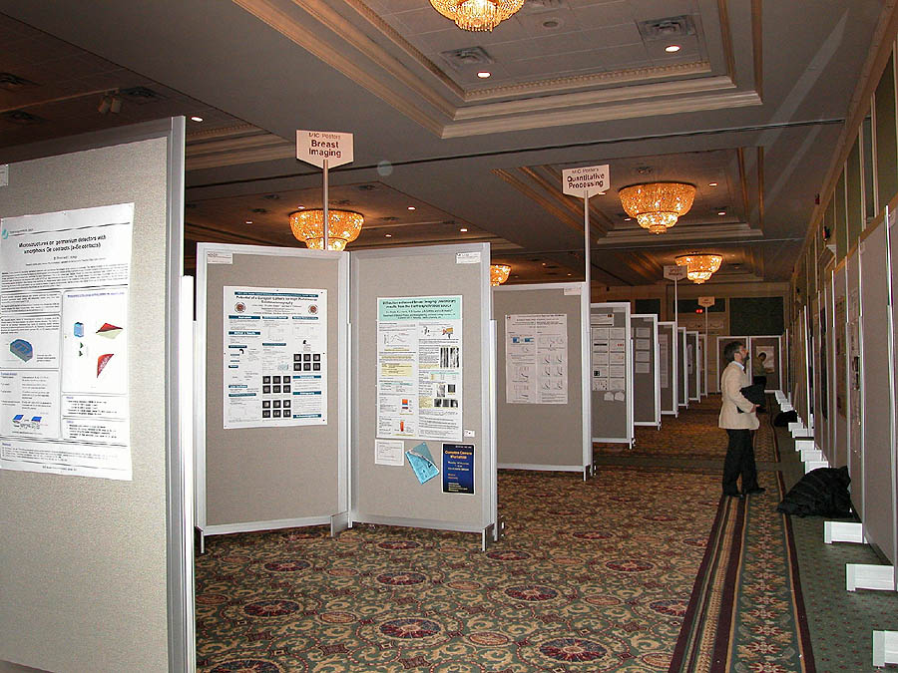

Plan: Requirements
Know Your Poster Requirements
  Do not assume that they are the same as for the last poster you made
  Know how you are to display the poster
  Know when you must be present.
  Do not assume that the sponsor will provide tacks, tape, easels, etc. Bring your own.
  Plan how you will travel with the poster to the conference
25 Posters

Slide 5
Plan: Requirements
Saluki Engineering Company poster requirements
  Title centered and legible from across the entry way or room
  Team members’ names and SEC Reference number
  Name and logo of real-world client, if there is one
25 Posters
25 Posters

Slide 6
Plan: Requirements
SEC requirements continued
  Fit on one standard size tri-fold poster board (4’wide x 3’high)
  State the problem that is to be solved
  Include appropriate block diagram or equivalent of the system
  Summarize the overall solution and the major parts of the solution referring to the block diagram
  Use text that explains each graphic and clearly indicates which text goes with which graphic
25 Posters

Slide 7
Plan: Requirements
SEC Poster Requirements (mid-project)
An indication of what work has been done so far
Design-Build Projects: an estimate of the cost of the prototype
Design-Study Projects: Your best estimate of the cost to implement your system and an indication of what is included in the estimate, e.g., Cost of major equipment, Cost of major equipment plus labor to install
25 Posters

Slide 8
Plan: Requirements
SEC poster requirements (end-of-project) continued
  Indicate the cost
    of the prototype
    to manufacture the device
    to install the modifications
    to construct the facility
  Indicate the implementation schedule
    to build the system
    to manufacture the device
    to install the modifications
    to construct the facility
25 Posters

Slide 9
Plan: Visual Effect
CONSIDER VISUAL EFFECT
Use text to identify the problem and describe the solution
Use graphics, photographs and drawings, to illustrate your design
  Every graphic will have a figure number and title
  Every graphic will be discussed in the text
25 Posters

Slide 10
Plan: Visual Effect
CONSIDER VISUAL EFFECT of COLOR
Use color to tie related pieces together
Use color to establish a theme
Use the Client’s corporate colors
Avoid large areas of fluorescent colors
25 Posters

Slide 11
Assemble Poster materials
For all posters:
  Tri-fold poster board
  Title banner
  Text and graphics
For cut-and-paste posters:
  Use PowerPoint and print out slides
  Foam backing (optional)
  Cutout frames or background frames for text and graphics
  Foam backing for frames (optional)
  Rubber cement, or spray adhesive
For HP 500 Plotter Posters
  Instructions follow for using Edge Diagrammer and are in the Resources section of WebCT. Also, you may use Microsoft Publisher or PowerPoint and print a handout page of all slides.
25 Posters

Slide 12

Using Edge Diagrammer
& the HP DesignJet 500
Start Edge Diagrammer by clicking on
Go to File > Printer setup and select HP DesignJet 500 24 by HP then select a paper size that will fit on your poster board. The largest size you can specify is ANSI D – 22 x 34 in. Select Landscape and click OK
25 Posters

Slide 13
Using Edge Diagrammer
& the HP DesignJet 500
Hover the cursor over buttons to get a popup description
Right click items you have placed on the document to change their properties
The Help menu is actually useful
To get started you will need to choose a template: General Purpose Diagram is the one you will probably want
25 Posters

Slide 14
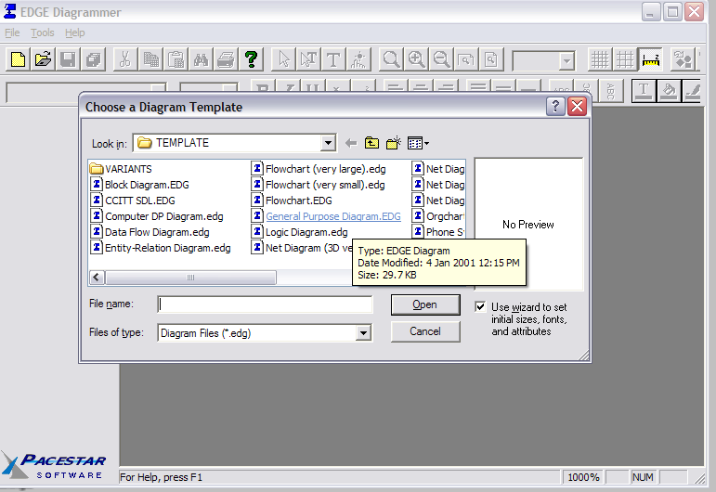
Using Edge Diagrammer
& the HP DesignJet 500
25 Posters

Slide 15
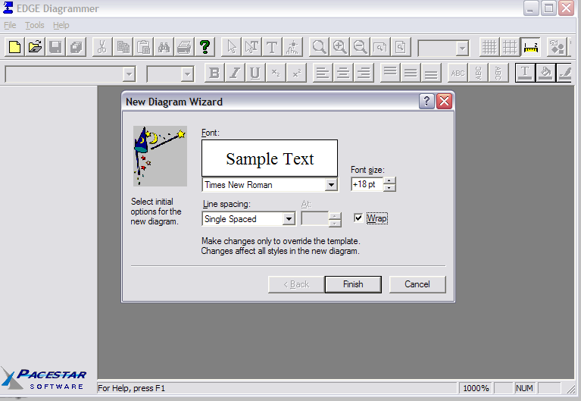
Using Edge Diagrammer
& the HP DesignJet 500
Setting the font and font size you will use most frequently will save you some time:
25 Posters

Slide 16
Using Edge Diagrammer
& the HP DesignJet 500
To add a shape: click on the one you want and click where you want it
To change its properties, right click the shape
To see more shapes, click on the dark arrow in the lower right of the shapes bar; then to see more, click on the ellipsis (…) in the lower right
25 Posters

Slide 17
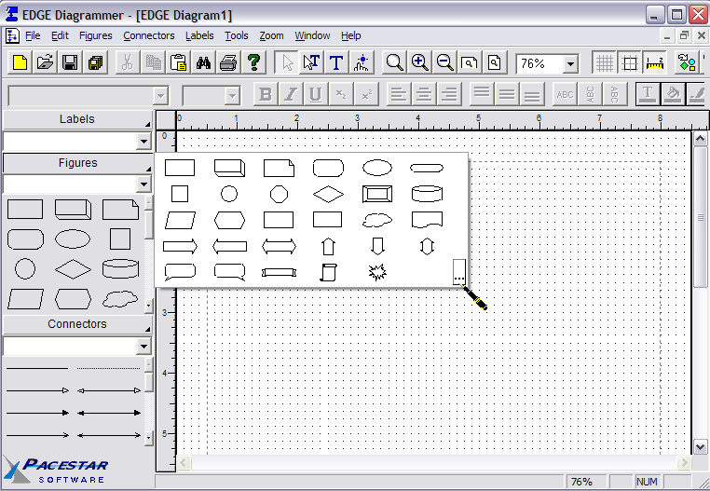
Using Edge Diagrammer
& the HP DesignJet 500
25 Posters

Slide 18
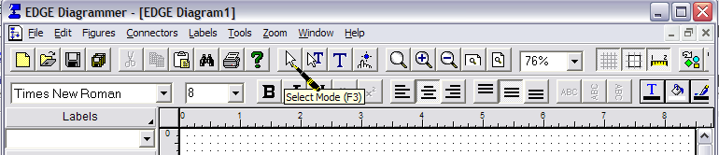
Using Edge Diagrammer
& the HP DesignJet 500
When you are finished placing shapes and want to change properties, click on the Select button
To add text, click on the Text button (second to the right of the Select button)
25 Posters

Slide 19
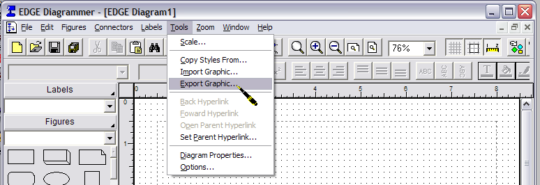
Using Edge Diagrammer
& the HP DesignJet 500
To import your own graphics, first convert it to a WMF, EMF, BMP, DIB, or JPG file
25 Posters

Slide 20
Using Edge Diagrammer
& the HP DesignJet 500
To design your poster on your own computer and bring it to E215 to print, you will need to install:
  Pacestar Software’s Edge Diagrammer and the driver for the HP DesignJet 500 24.
  Edge Diagrammer is shareware and you can use it for free for 30 days.
  Download and install the driver for the plotter from the HP website; your computer does not have to be physically connected to the plotter.
Do NOT design it smaller and try to scale it up for printing
25 Posters

Slide 21
Construct Poster
Plan the layout to make creative use of the available space
Layout the text and graphics
Cut the background or cut-out frames to fit attractively
Check for the C’s:
  Clear
  Complete
  Correct
  Consistent
  Creative
  Cost, time, & identification
  Concise & uncluttered
25 Posters

Slide 22
Display Your SEC Poster
Display it on a table on the first floor of Engineering Building E
Construct the poster well enough to stay together for one week
Post your poster as JPG to your Web Space:
  For plotter posters, save a copy as a JPG file from Edge Diagrammer
  For paper and pencil posters or posters embellished with lights or materials from the project, take a picture with a digital camera
25 Posters

Slide 23
Poster Presentations
Summary
Plan your poster to meet the requirements and showcase your work
Assemble your materials and work out the details of the layout
Use a plotter or printer to construct your poster professionally. Cut straight edges straight, no bubbles or ripples, erase all guidelines
Display your poster with pride
25 Posters

Slide 24
SEC printers and plotters
The Senior Design Lab EGR E215
  color Plotter with a two-foot wide roll of paper
  color laser Printer
available for final copies of 495B posters and reports.
See Nancy Beasley EGR E209 for an account.
25 Posters

Slide 25
Poster Presentations
Questions?
25 Posters

Slide 26
Poster Presentations
Posters are due at 3PM April 28th.
Thank you for your time and attention.
See you at the next regularly scheduled staff meeting.
25 Posters

